Slide 1
CIS 541 Fundamentals of Big Data Project Proposal
Xiomara Chirinos
Raul Ramon Rodriguez
Rene Villarreal

Slide 2
Climate Change in Miami-Dade County
How has daily precipitation and daily temperatures shifted in the county over the past 110 years?
According to Nasa, global temperatures have risen about 1.62 degrees Fahrenheit since the late 19th century.
It is thought to be driven largely by human-made emissions into the atmosphere.
Most of the warming occurred over the past 35 years.
According to the EPA, as the air becomes warmer and more moisture evaporates, rain and snow patterns have increased over the past two centuries.
References:
Climate Change Evidence: How Do We Know? (2020, May 27). Retrieved September 26, 2020, from https://climate.nasa.gov/evidence/
Changing Rain and Show Patterns. (2017, May 9). Retrieved September 26, 2020, from https://archive.epa.gov/climatechange/kids/impacts/signs/precip-patterns.html

Slide 3
Analyses & Data
Using linear regression, non linear regression, and time series analysis we plan on answering the following questions:
Does average daily temperature and max daily temperature affect precipitation?
Are the average daily temperatures in one station significantly different than in another station?
Based on the regression models, what kinds of temperatures can we expect in the next decade (2020 through 2030)?
Data source is NOAA. They have a data extraction tool on their website going back to 1910 for Miami Dade County.
NOAA contains approximately 13GB of data for Miami Dade County, and 2GB will be used for the project.

Slide 4
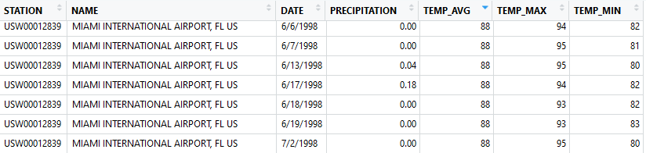
Dataset
Station: NOAA Station where temperatures and precipitation was measured
Name: Name of location where station is located
Date: Date of measurement
Precipitation: Rain in inches for the day
Temp_Avg: Average temperature for the day in Fahrenheit
Temp_Max: Maximum temperature for the day in Fahrenheit
Temp_Min: Minimum temperature for the day in Fahrenheit

Slide 5
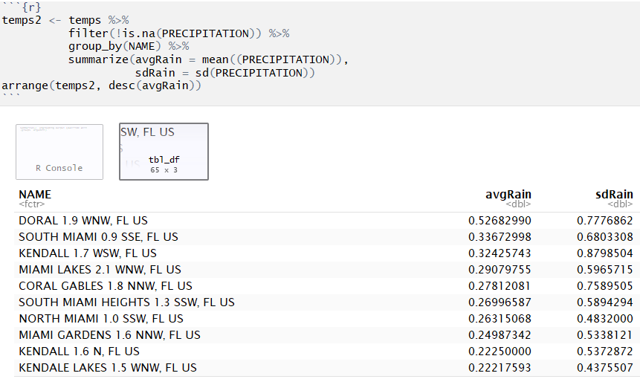
Data Summary
Doral tends to have the highest amount of rain in inches

Slide 6
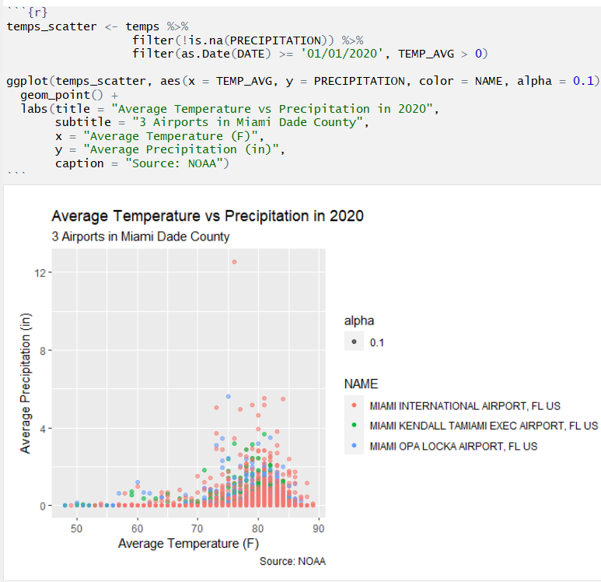
Scatterplot

Slide 7
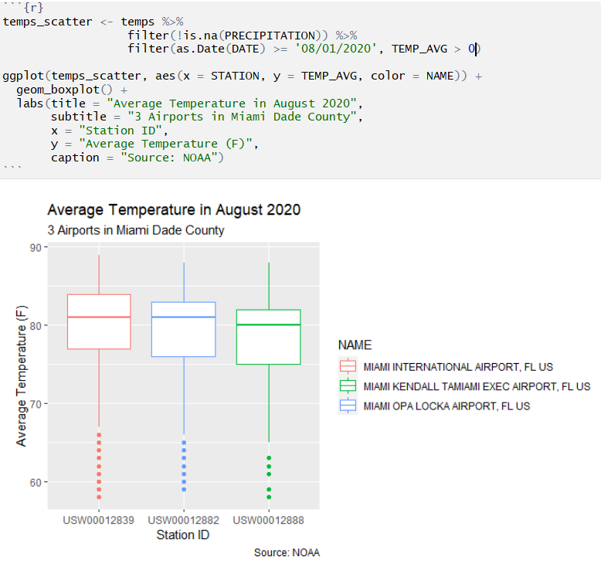
Boxplot

Slide 8
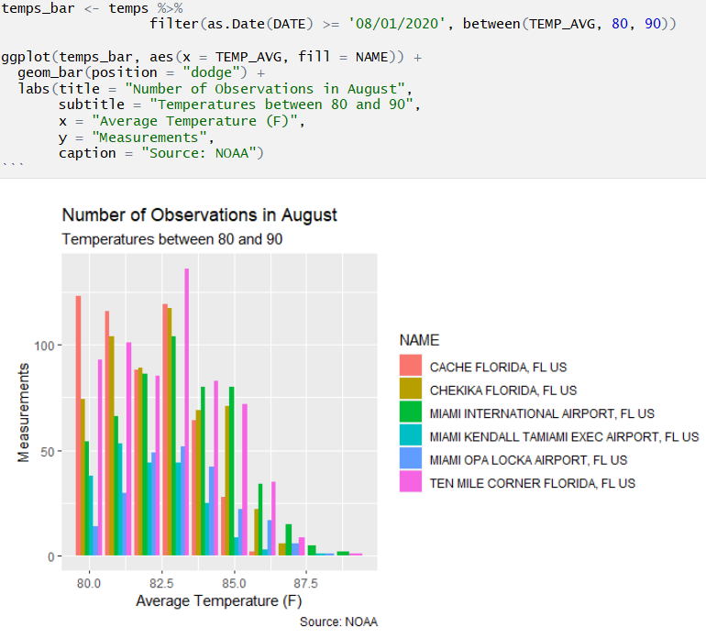
Bar Graph

